Slide 1
Hermes Microvision, Inc. Presents
Case Study

Slide 2
Hermes Microvision, Inc. Presents
P leak experience
Contact WCMP Layer
Notes:
2

Slide 3
Summary
For P leak detection on “Smaller DR” (Like 28nm_WCMP or below)
Positive mode:
Condition setting is easy.
Normal PMOS is not very bright.
P leak is very bright and easier to be detected.
Negative mode:
Condition window is narrow.
Normal PMOS is bright and P leak behaves as DVC.
For P leak detection on “Larger DR” (Like 45nm_WCMP or above)
Positive mode:
Condition setting is easy.
Normal PMOS is very bright.
P leak behaves very bright and hard to be detected.
Negative mode:
Condition window is wide.
Normal PMOS is bright and P leak behaves as DVC.

Slide 4
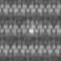
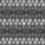
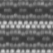
P Leak Behaviour btw Different DR – Positive Mode
Positive Mode = LE<E2 at Extraction Field
PE
Extraction Field
Extraction Field
PE
With Larger DR
Not much SE been extracted from P leak
P+
N-well
N+
P+
P-leak
P-well
STI
N-well
P-sub
P-sub
With Smaller DR
Simplified CMOS structure for analysis
Extraction Field
PE
More SE could be extracted from P leak
Small DR
Medium DR
Large DR
Patch image
P+
N-well
For GL of normal PMOS: Large DR>Medium DR>Small DR
For S/N of PLeak: Small DR>Medium DR>Large DR
P-leak
P-sub

Slide 5
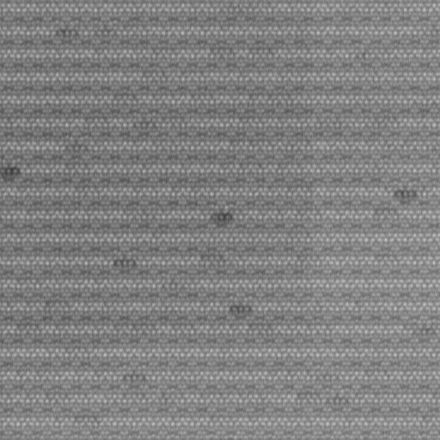
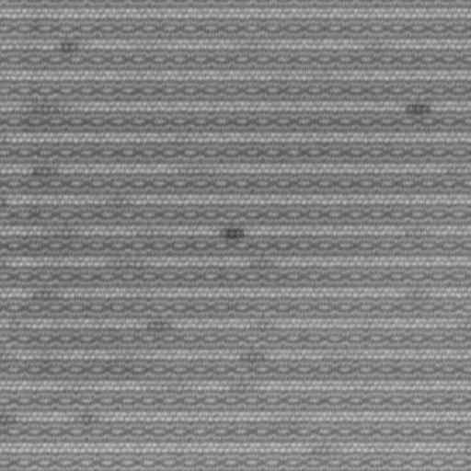
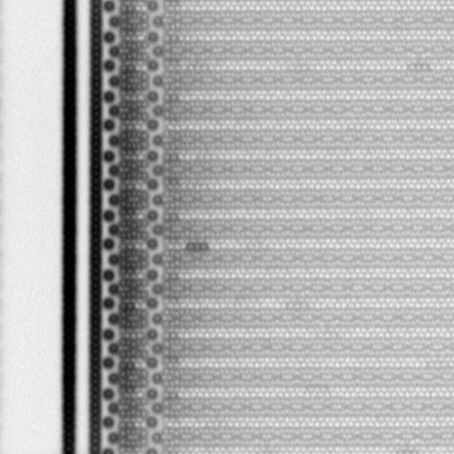

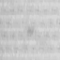
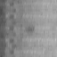
P Leak Behaviour btw Different DR – Negative Mode
Negative Mode = LE>E2 at Weak Extraction or Retarding Field
PE
Retarding Field
Retarding or Weak Extraction Field
PE
With Larger DR
More SE could be suppressed from P leak
P+
N-well
P-leak
N+
P+
P-well
STI
N-well
P-sub
P-sub
With Smaller DR
PE
Simplified CMOS structure for analysis
Retarding Field
More SE could be suppressed from P leak
Small DR
Medium DR
Large DR
Review image
Patch image
P+
N-well
P-leak
For negative mode window: Large DR>Medium DR>Small DR
For S/N of PLeak: Small DR>Medium DR>Large DR
P-sub

Slide 6
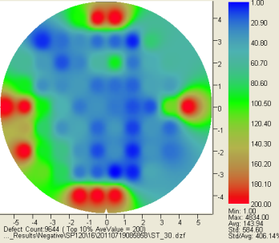
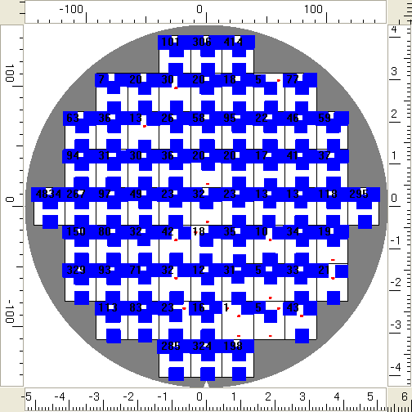
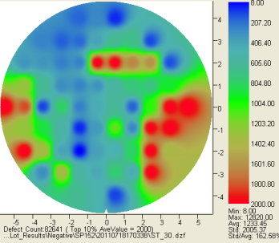
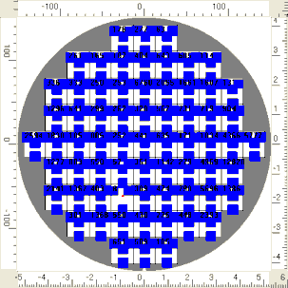
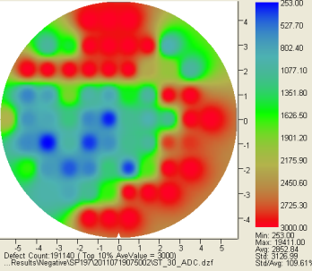
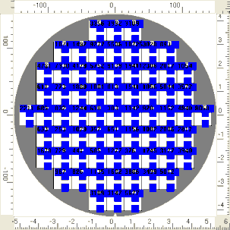
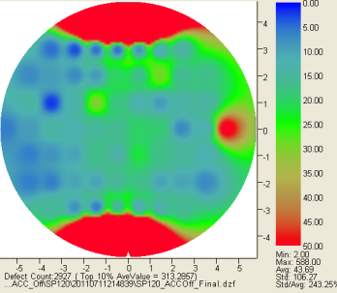
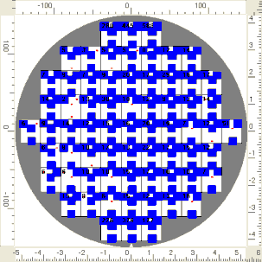
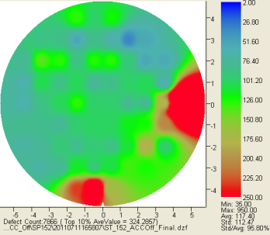
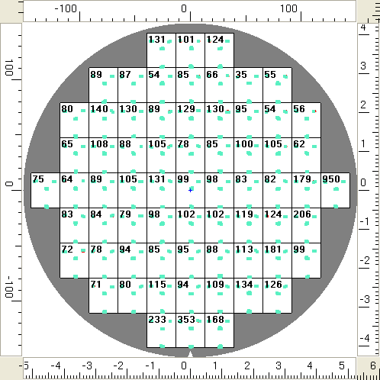
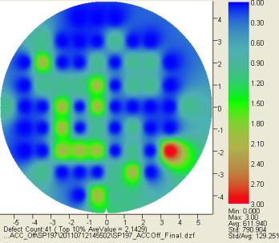
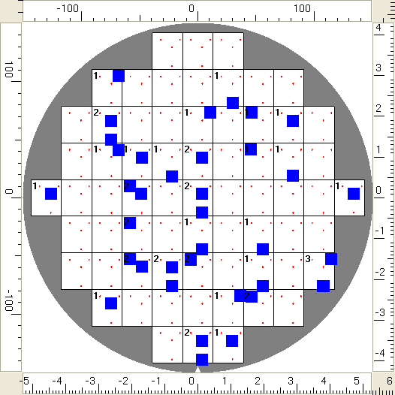
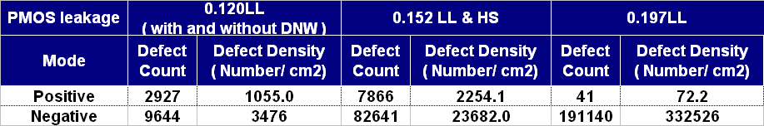
PMOS Leakage using Positive and Negative Modes –
SP0.120
SP0.152
SP0.197
Negative mode
Positive mode
Any explanation for the reversal of defect counts’ trend in Negative mode?

Slide 7
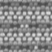
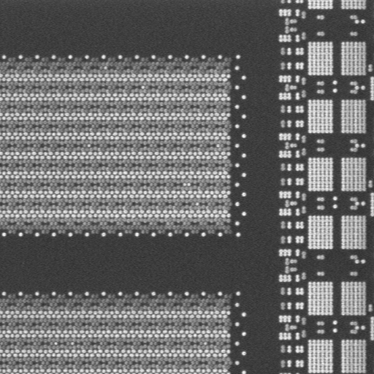
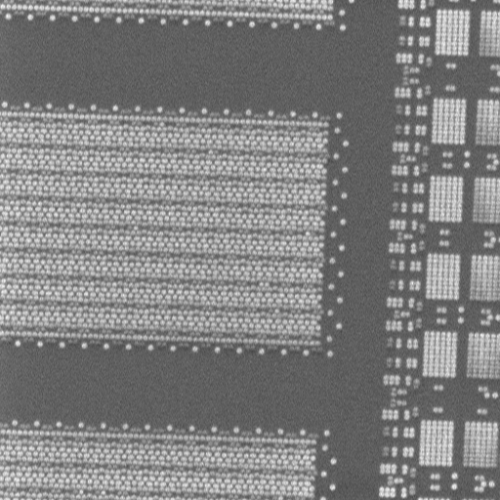
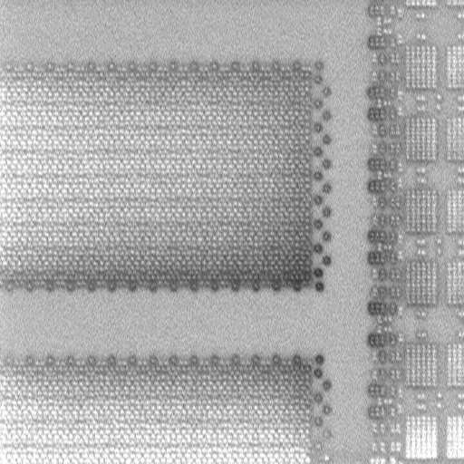

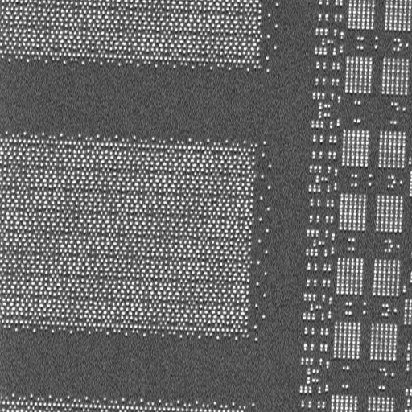
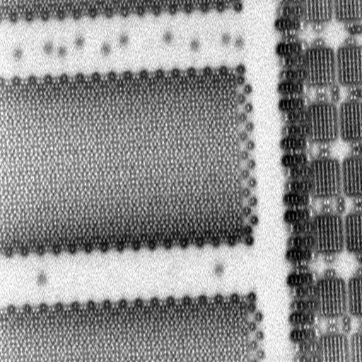
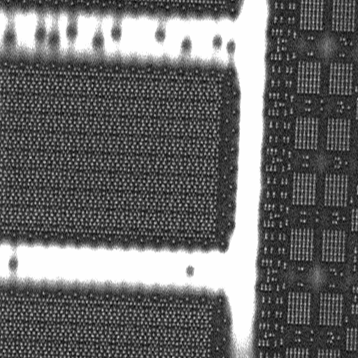
Negative Mode Window is very narrow on small pixel size.
500eV.No.5_2500
1000eV.No.5_0
1500eV.No.5_-1500
Didn’t capture any P-leak by using negative mode.
2000eV.No.5_-2500
2500eV.No.5_0
2500eV.No.5_-2000
Condition : 20nm.15nA.3000eV.No.5-3000.4D1F

Slide 8
Example of Condition Tuning
Negative Mode
WCMP PLeak with small DR

Slide 9
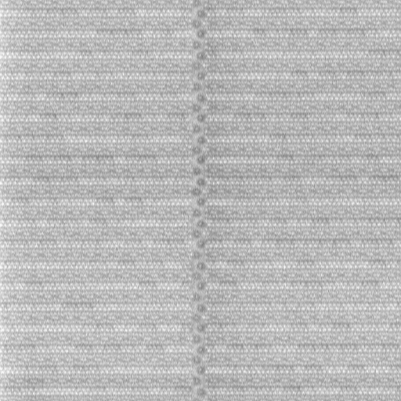
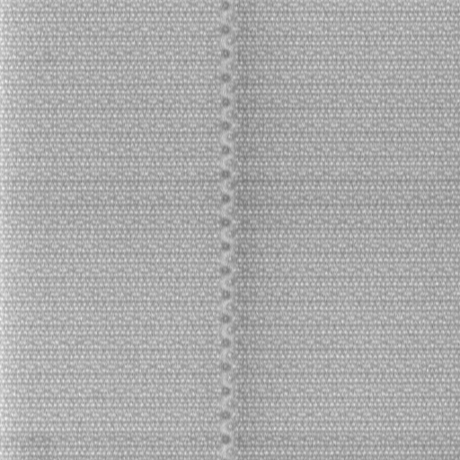
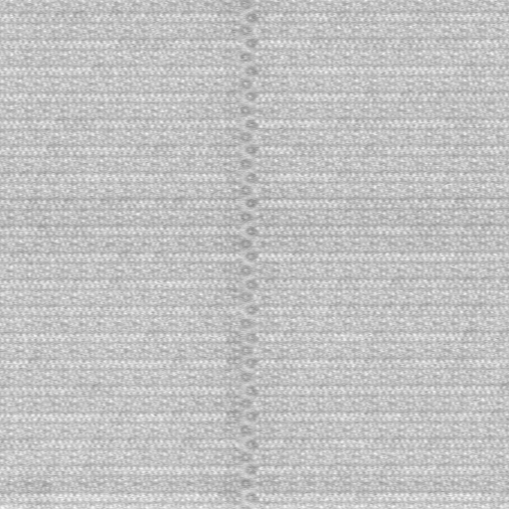
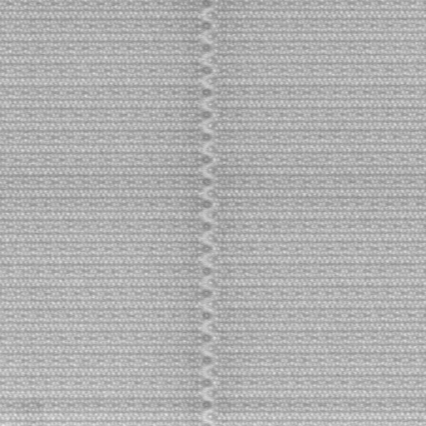
Condition: Scan Direction & ACC
ACC | OFF | ON
X
Y
25nm_2500eV_-1500No5_apt1_100nA_1D1L1F

Slide 10
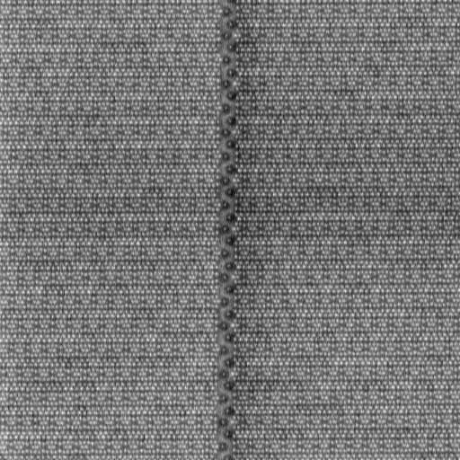
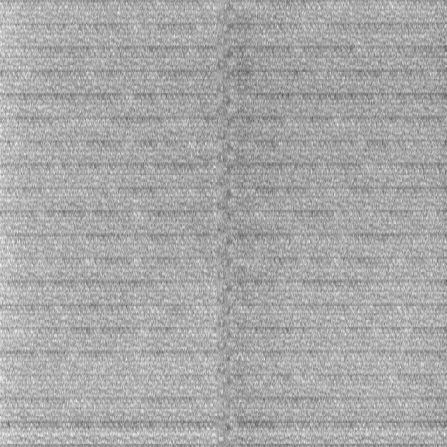
Condition: L.E Comparison
25nm_-1500No5_apt1_100nA_X_1D1L1F_ACCOff
3000eV
2500eV
2000eV

Slide 11
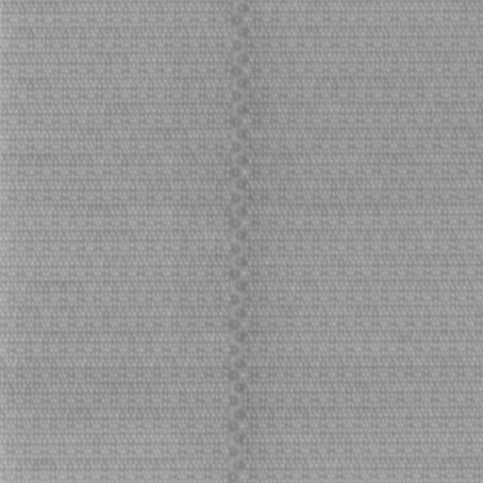
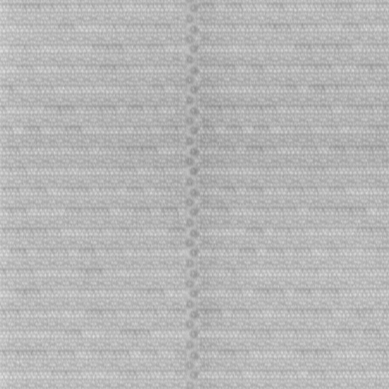
Condition: L.E 3000eV vs. 2500eV
25nm_-1500No5_apt1_100nA_X_1D1L2F_ACCOff
3000eV
2500eV

Slide 12

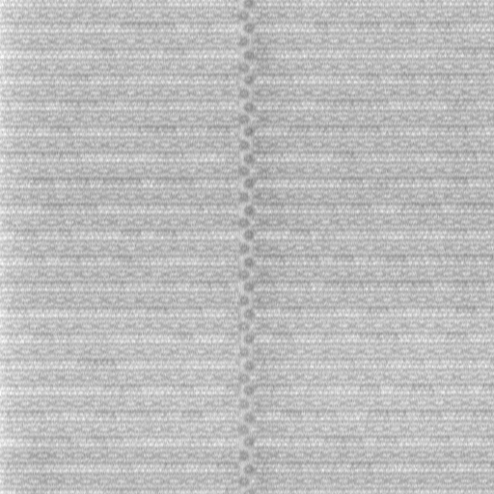
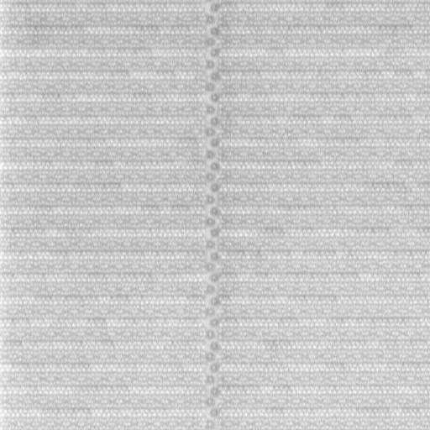
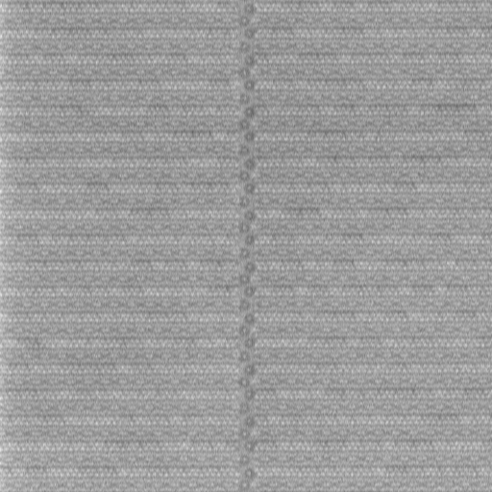
Condition: Probe Current Comparison
25nm_2500No5_X_1D1L1F_ACCOff
Ap1_70nA
Ap1_100nA
Ap1_125nA
Ap1_150nA

Slide 13
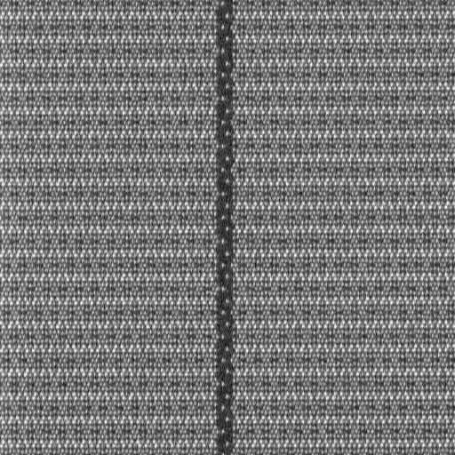
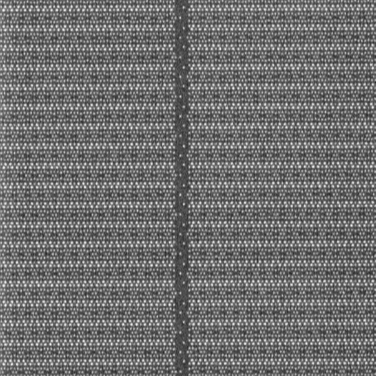
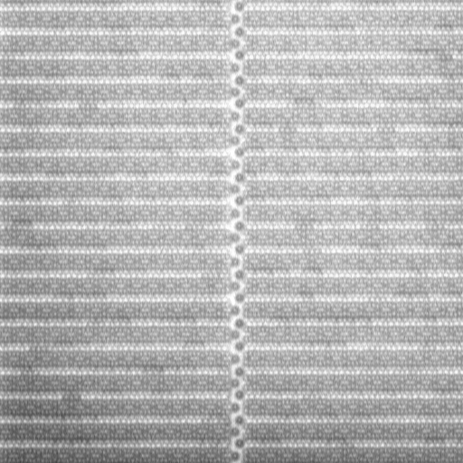
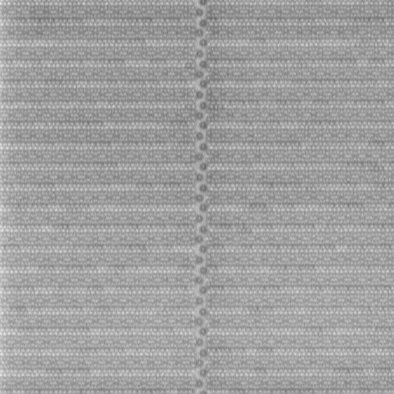
Condition: No5 Comparison
25nm_2500eV_apt1_125nA_X_1D1L1F_ACCOff
-2500No5
-2000No5
-1500No5
-1000No5
-500No5

Slide 14





Condition: Average with Large Pixel Size (50nm)
50nm_2500eV_-1000No5_apt1_125nA_X_ACCOff
1D1F
2D1F
4D1F
1D2F -- HT
1D2F
1D4F -- HS

Slide 15
Example of Condition Tuning
Positive Mode
WCMP PLeak with small DR

Slide 16
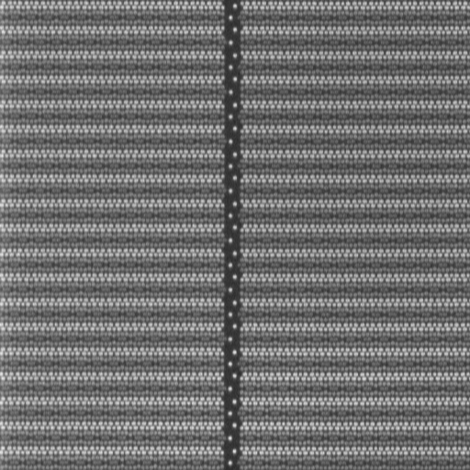
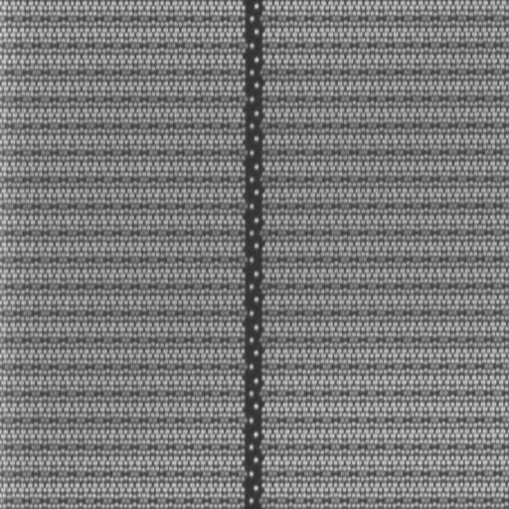
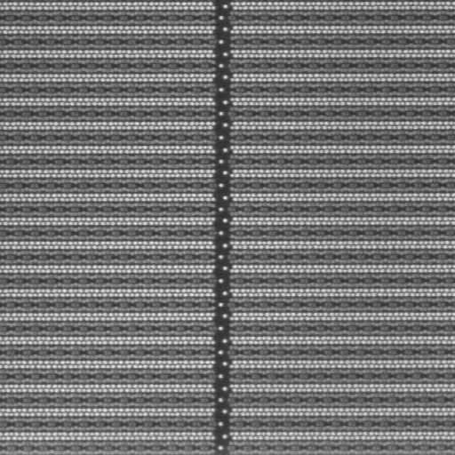
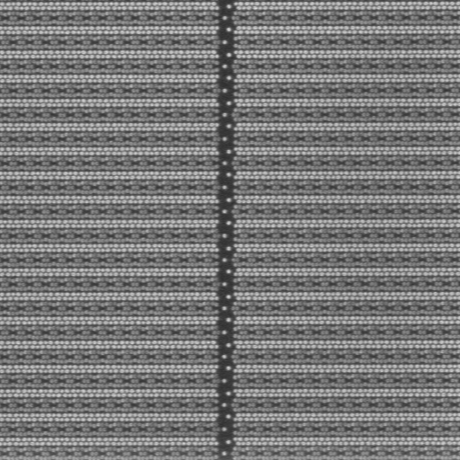
Condition: Scan Direction & ACC
ACC | OFF | ON
X
Y
Easy to detect both DVC and BVC
25nm_500eV_2000No5_apt2_40nA_1D1L1F

Slide 17
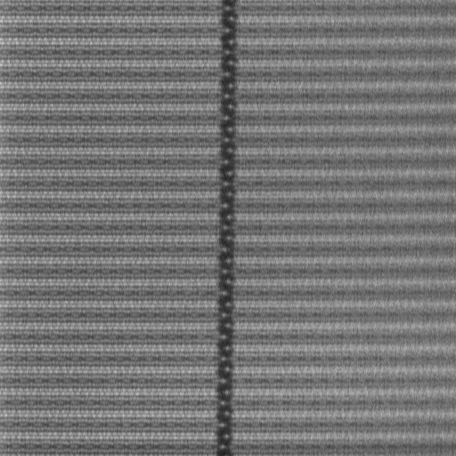
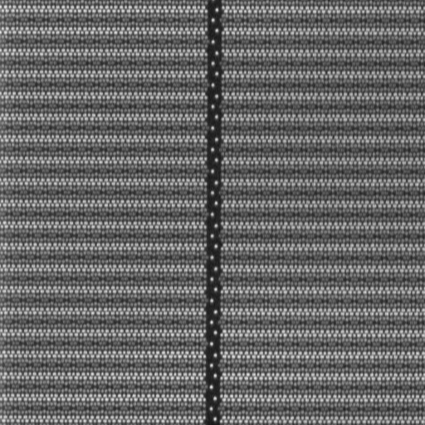
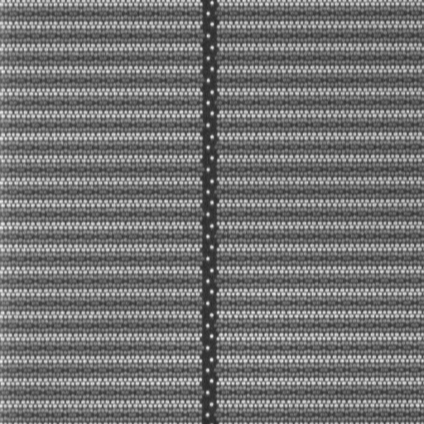

Condition: L.E Comparison
25nm_2000No5_apt2_40nA_X_1D1L1F_ACCOff
100eV
300eV
500eV
1000eV

Slide 18
Condition: L.E 300eV vs. 500eV
25nm_2000No5_apt2_40nA_X_1D1L1F_ACCOff
300eV
500eV

Slide 19



Condition: Probe Current Comparison
25nm_2000No5_X_1D1L1F_ACCOff
Ap3_20nA
Ap2_30nA
Ap2_40nA
Ap1_50nA

Slide 20



Condition: No5 Comparison
25nm_300eV_apt2_40nA_X_1D1L1F_ACCOff
1000No5
1500No5
2000No5
2500No5

Slide 21
VNAND Under-etch Detectability
− 10nm under-etch remain gap defects analysis
Important Notes:
Internal material for internal reference only. Energy filtering , 800Mhz and defocus pre-scan proposal are not presented to Micron customer.

Slide 22
Outline
Background
VC Theory for CT CMP
RC Model VC
Time to Charge Up – A Throughout Factor
Voltage to charge up – A sensitivity Factor
Challenge for VNAND
Why eScan cannot detect <10nm etch remains?
Dielectric Breakdown Limit
Capacitive VC Model
Resistive VC Model
Conclusions

Slide 23
Background
Micron 100 series VNAND gap defects:
21-to-45 under-etch. Residue is less than 10nm thickness: Root cause is unknown. Don’t know how to duplicate the under-etch. Defects signature can be found after the probe test. Need e-beam solution to detect defects at early step.
24-to-21 under-etch. Residue is less than 10nm thickness: Root cause is well known. Can duplicate and control the under-etch thickness, but need e-beam solution to detect it.
Capability of eScan
Micron’s experience: eScan400 has the capability to detect 21-to-45 and 24-to-21 under-etch which is thicker than 10nm.
Worldwide Experience: The best case detected is 6nm of under-each at WCMP stage

Slide 24
VC Theory (Normal CT)
Initial Status
At Equilibrium
PE
η=3
η=2
SE
0V
0V
0V
Develop Towards
Equilibrium
4V
0V
4V
SiO2
Si
SiO2
SiO2
Si
SiO2
I_{in}=I_{out}
e-
SE Image

Slide 25
VC Theory (Under-Etched CT)
Initial Status
At Equilibrium
PE
SE
0V
0V
0V
Develop towards
equilibrium
4V
3V
4V
SiO2
Si
SiO2
SiO2
Si
SiO2
I_{in}=I_{out}

Slide 26
VC Theory (DVC = Under-etched at Positive Charge)
Normal CT
Open CT
4V
0V
4V
At equilibrium
4V
3V
4V
SiO2
Si
SiO2
SiO2
Si
SiO2
I_{in}=I_{out}
e-

Slide 27
RC model for VC
I_{PE}
PE
I_{SE-BSE}(LE,Material)
e⁻
e⁻
e⁻
e⁻
e⁻
e⁻
SE
e⁻
e⁻
e⁻
e⁻
4V
3V
4V
I_{SC}
Si
SiO2
SiO2
I_{SC0}
I_{sc}(t)
I_{PE} = I_{SC} + I_{SE/BSE}
I_{SC :} Leakage current
V
R
Equivalent to RC circuits
C

Slide 28

Factors to Detectability ( Time and Voltage )
Initial Status
At Equilibrium
PE
Develop towards
equilibrium
SE
Planar devices
VNAND
0V
0V
0V
4V
3V
4V
SiO2
Si
SiO2
SiO2
Si
SiO2

Slide 29

Challenges for VNAND EBI
Extremely high AR (>40:1) makes EBI at AEI steps impossible for both physical mode (BSE) and VC modes.
At post CMP steps, increases in the distributed capacitors, makes EBI to take
extremely long time to charge up the CT Plug/DOI, thus prolonged pre-scan (>64 Frame average for positive mode) or extremely slow speed and small pitch pre-charge (for negative mode) are required.
Positive charges induced by PE on surface takes time to dwell to the entire devices. In opposite, it tend attract SE back to refrain the development of charging. So Pre-scan must use frame average (give longer dwelling time) and small current as well.

Slide 30
Improvements for VNAND – Throughout
Super Charger for VNAND
Pre-charging for Negative mode
Larger pre-charger beam current
Small spot size for higher dose density
Strong retarding field
Pre-charging for Positive mode
Medium beam current
Large spot size for Low dose density
Strong extraction field
Pre-scan
Fast defocus/refocus switching
Extremely low beam density
Higher scan rate
800Mhz Scan rate
Pre-charging
EBI

Slide 31
Throughout enhancement -- Pre-charging
Super Negative Mode
Larger pre-charger beam current
Already increased from 100uA to 200uA, further high current?
Small spot size for higher dose density
Focus is under testing
Strong retarding field (not discussed with Micron)
Currently max mesh bias is -20V, can be a limiting factor to 1) and 2).
Suggested to increase to -1000V.
Super Positive Mode
Smaller pre-charger beam current
Limited by ECC and gun, current is around 10uA. Not much space.
Large spot size for lower dose density
Limited by hole size, not much space.
Strong extraction field
Currently maximum mesh bias is 60V, target on +1000V for an effective way to boost positive charge (not discussed with Micron)

Slide 32
Throughout enhancement – Optimized Pre-charging control
Pre-charge kept warm
Already implemented
CS-like control of pre-charge
Follow CS inspection style for Pre-charging
Can be area based, and acerbated speed between areas
Can be inserted in inspection and activated during inspection.
Pre-charging at SEM mode (with HV on) (not discussed with Micron)
Improved ECC control
Now ECC control algorithm
Faster, more reliably, more stable pre-charging process

Slide 33
Throughout enhancement – Defocused Pre-scan
Pre-scan more effective by defocused primary beam
Pre-inspection with severely defocused primary beam proven to be more effective to reach targeted positive charge.
Cannot integrate into pre-scan due to the need to coarse focus change severe hysteresis effect when switch back to original fine focus.
Faster defocus/refocus mechanism is needed to boost the throughput. (not discussed with Micron)
Electrostatic lens defocus rather than magnetic lens defocus is needed
Stage bias or No5 bias is electrostatic, but speed is limited as it is foliating on high voltage, and change voltage is limited
Suggested to apply DC voltage bias onto the unused defector during pre-scan step.

Slide 34
Throughout enhancement –Frame Average Pre-scan
Why DOT/LINE average does not work well for positive pre-scan (not discussed with Micron)
8Dot average
-- cannot reach the targeted voltage (dot line)
V
Ideal RC charge up curve
8Dot average
-- cannot reach the targeted voltage (dot line)
Due to the limited dwelling time, charge is more confined locally and strong local charge will prevent SE from escaping and building up higher positive charge, so DOT/Line average will not achieve a surface voltage close to the ideal case.

Slide 35
Throughout enhancement –Frame average pre-scan
Why FRAME average works well for positive pre-scan (not discussed with Micron)
800Mhz 8Frame average
-- Takes long time to reach to targeted voltage
Ideal RC charge up curve
V
1 frame time=512xpixel time
1 pixel time
1 pixel time=2.5ns
Frame average will charge up the relatively large area frame by frame gradually. During each frame, the charge build up is more evenly, not much strong local field or strong force to attract back SE to restrain the charge build up. Eventually the final voltage can reach a level much closer to the ideal case.
The drawback of this case is the frame time is too long, far more than necessary for the step by step charge up. If we can reduce the frame time by half, or one third, then there will be a big benefit to throughput.

Slide 36
Throughout enhancement – Why 800Mhz ?
Why 800Mhz is good for throughput? (not discussed with Micron)
Ideal RC charge up curve
400Mhz 8Frame average pre-scan
-- Takes long time to reach to targeted voltage
V
1 frame time=512xpixel time
1 pixel time=2.5ns
1 pixel time
800Mhz 8Frame average pre-scan
-- Takes long time to reach to targeted voltage
Ideal RC charge up curve
V
1 frame time=512xPixel time
1 pixel time=1.25ns
Preliminary results indicated that 800Mhz improve THP by 30%

Slide 37
Improvements for VNAND – Sensitivity
Notes:
Unlike the charge up time, which can be more or less controlled by SEM condition, the final voltage built up on the under-etched CT is determined or limited by devices/thickness of remains.
Improvement can be done in the follow aspects
More effective Pre-scan with primary beam
Faster Defocus/Refocus Design
More controllable parameters (scan direction, No.5 bias voltage, beam current, etc)
High extraction field
High S/N image channel (from detector to amplifier)
Ultraviolet laser may enhance ACC effect for positive mode (Not discussed with Micron)
Energy Filter (Not discussed with Micron)

Slide 38

VNAND Gap Defect Analysis - Why eScan cannot detect <10nm etching remains
Fundamental physics / Models used to describe the gap defects
Dielectric breakdown strength E of the SiO2
Where d is the remain thickness of SiO2
Capacitive VC Model
Resistive VC Model
Where V refer to the charging voltage built up on the defective CT. It should meet a critical level so that the Coulomb force can be strong enough to affect the trajectories of SEs emerging from it.

Slide 39

Dielectric Breakdown Limitation
Some important properties of pure SiO2:
* source: TimeDomain CVD, Inc
Maximum charge up voltage on 10nm film before breakdown
Vmax = 10.0V (for Thermal Oxide) or
1.0V (for CVD oxide)

Slide 40
Properties of SE / Signal Electrons Energy Spectrum
Wide energy spectrum of signal electrons
0<SEs <50eV, peaked at around 2eV.
VC image is mainly SE image, If the charging voltage high enough, at least, in the same order as SE energy, its trajectory will affected and collection ratio is thus changed accordingly.

Slide 41
Is 1V charging high enough for VC defects?
Yes
10nm CVD SiO2 (E=0.1V/nm is assumed) may build up a maximum voltage of 1V, so 10nm remain maybe detectable
Worldwide experience confirmed our capability is around10nm. Best case is 6nm on Logic WCMP layer.
But, Some factors may make the answer not so simple
Variation on dielectric properties
Material and Process variations
Device and Structure variation
Dielectric permanent damage charge breakdown, it become a high resistant conductive contact, no long an open contact.
EBI is insensitive to Resistive VC (to discussed later)

Slide 42
More about RC model
I_{PE}
Charge current = I_{SC} (t)
= I_{PE} –I_{SE}(t)= I_{PE} (1-η (t))
Where η(t) is the effective yield of total electrons (SE+BSE), varies with surface charging status and reaches 1 at equilibrium
The total voltage across C and R are
I_{SE}
4V
3V
4V
I_{SC}
I_{sc}(t)
V
R
C
Capacitive VC
Resistive VC

Slide 43
Capacitive VC Model
I_{sc}(t)
R
V
Rc
C
Cc
If CT not open, no voltage build up. If CT open, Cc comes in
Assuming VNAND contact size is 0.06um, etch remain of SiO2 (k=3.9) is 10nm, capacitor can be estimated as a parallel capacitor:
Cc= ε _{o} kA/d ≈ 0.9x10⁻¹⁶F
C is equivalent to side-well (storage nodes) capacitors. It should be much larger than Cc, unless there is severe under-etch
The charge up voltage will be over several volts, easily breakdown the SiO2 remain. So the voltage is dielectric breakdown limited.

Slide 44
Resistive VC Model
Once breakdown (sometimes permanent damaged), CT is then behaved as a high resistant. Now the question is how sensitive for EBI to detect resistive VC?
Let’s ΔR to be the difference of resistant of high resistant contact to a normal contact, i.e. ΔR=R(high)-R(normal), the extra voltage built up on the high resistant will be
V ≈ I_{SC}* ΔR= I_{PE} (1-η) * ΔR
To reach the detectable voltage of 1V sensitive to SEs, assuming I_{PE} =20nA, and η=1.5, the incurred resistant should be
ΔR=1V/10nA=100MΩ
Even with use of higher current of 100nA, ignoring the deteriorated image resolution, the detectable high resistant is still need to be 10MΩ.

Slide 45

Why EBI insensitive to Resistive VC?
Detection threshold in terms of resistance is around 20MΩ

Slide 46


Why EBI insensitive to Resistive VC?

Slide 47
Possible Solutions to Narrow The Gap
Higher beam current
Higher extraction
Abovementioned measures may shrink the barrier from 10MΩ to 1MΩ.
Test Structures
Raise the reference resistant to the marginal level of detection, say 1MΩ, if High resistant contribute 0.5MΩ, may increase the detectability.
Two layers of dielectric films, etch stop at bottom layer, always
CDU measurement and monitoring
Energy filter (not discussed with Micron)

Slide 48
Energy filter – What Can Do?
Energy filter selectively filters unwanted signals and keeps the remaining signal more dominantly representing a particular characteristic of the defects (not discussed with Micron)
For physical/material defects
Filter out Low energy SE, so that the BSE image will be more representing materials contrast. (equivalent to No.5 biasing)
For Bottom defects of High AR structure
Only electrons (SE and BSE) escaped at particularly small angle are detected, so that for SEs escaping from the bottom of a high AR structure are not overwhelm shadowed by the background signals
For Hi-resistant or low sensitive VC defects
Filter out high energy SE so that only low energy SEs are kept in forming the SE image, so the VC sensitivity can be enhanced, even some high resistant defect can be detected
Without angular (energy) filtering, bottom signal is just a ignorable fraction of background signal
With angular (energy) filtering, bottom signal account a significant portion of total signal. Good for detection residue of different materials

Slide 49
Energy Filter for Resistive VC defects (not discussed with Micron)
All electrons from 0eV to LE will be detected if contact is normal
No energy filter, no electrons filtered
This portion of low energy SE (<0.5eV) will be attracted and miss the detector due to high resistant
Contrast =∑ / ∑ ≈0
All electrons from 0eV to LE will be detected if contact is normal
Higher energy Electrons filtered
This portion of low energy SE (<0.5eV) will be attracted and miss the detector due to high resistant
Contrast =∑ / ∑
More average is needed for this case

Slide 50
Summaries
Theoretically, from basic model, our best DOI sensitivity is 10nm thickness CVD oxide. Better oxide quality(higher break down voltage) can push the limitation to less than 10nm.
From the cross-section data, the best thickness eScan400 ever achieved is 8nm.
We are reaching the fundamental limitation for the gap defects. Due to the complexity of VNAND 21 and 24 layers, basic model may be not good enough. We need to do some experiments to see the real tool limitation. RDA generated a layer 24 dose field wafer and will cross-section it. Using that wafer to fine adjust our recipe will tell us where is the tool limitation.
Inspection or CDU at 24ACI /21ACI might be another solution.
Energy filter may be a solution for improving high resistant defects sensitivity.

Slide 51
Special Pre-scan

Slide 52
Case 1: Time delay to gain most S/N on DOI The Best prescan effect was after full image has been pre-scanned
Discharge too slow
Discharge too fast
Surface Voltage
Defect
Defect
Defect contrast
Defect contrast
Normal
Normal
Need sub-frame
Full image PreScan
Delay time
SNC case : 20ms
Time
Time
Full image PreScan
After delay time, different discharging rate between Defect and Normal plugs make high defect contrast.

Slide 53
Case 1: Use sub-frame to gain most S/N on DOI The Best prescan effect was during full image pre-scanning
Without sub- frame pre-scan, we can run full image pre-scan only.
Pre-scan effect dissipate once the area is > 1M.
So, DOI is too weak to be captured.
1024 pixel
1024 pixel
Sub-frame: 512 pixels.
Total area on each sub frame = 2048*512=1M
Could gain most LFOV to improve the TP w/ PreScan effect
Max. FOV to keep the pre-scan. Total area is ~ 1M pixels
Pre-scan
2048 pixel
Inspection

Slide 54



Special Pre-scan on the GUI
Check the “Enable Advance Scanning Control.
Use 8D1D1F on prescan average for this Hynix SNC case.
Put None and 20 on Sub_Frame and Delay time.
Click “Advance Scan” to see the detect of HS and background lattice is clear.

Slide 55

Special Pre-scan on the recipe
Double click of the average bottom.
Put the inspection setting for the average of Dot, Line and Frame. For this case, we should set 16D1L1F
Click “Advance bottom”
Use the exact same parameters same as GUI site.
Then, save the recipe

Slide 56



Sub-Frame Mode
(Scan width 512)/(SubFrame32)=16
(Scan width 512)/(SubFrame64)=8
01
02
03
04
05
06
07
08
09
10
11
12
13
14
15
16
01 02 03 04 05 06 07 08
ex) SubFrame : 32 / SEM 512 mode case
1/16 area prescan & 1/16 area scan… X 16 times.
ex) SubFrame : 64 / SEM 512 mode case
1/8 area prescan & 1/8 area scan… X 8 times.

Slide 57
Thank You !!

